Slide 1
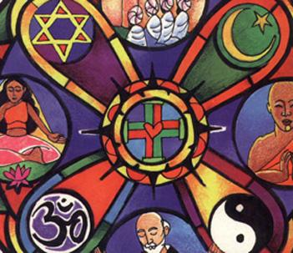
Belief Systems

Slide 2
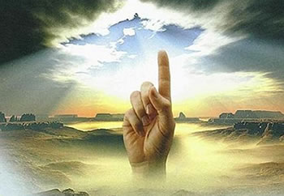
Branches of Religion
polytheistic monotheistic
Examine the images and create a meaning for polytheism and monotheism. Brainstorm examples of monotheistic and polytheistic religion.
Notes:
Examine the images and create a meaning for polytheism and monotheism

Slide 3
What is polytheism?
The belief in many gods
Poly = many
The = god or deity
Deity – synonym for gods

Slide 4
What is monotheism?
Monotheism: belief in one god
Mono = one
the = god

Slide 5
Turn and Talk Modern Day
DISCUSS:
What modern day examples from books, movies and video games reflect polytheism? (example: Percy Jackson)

Slide 6
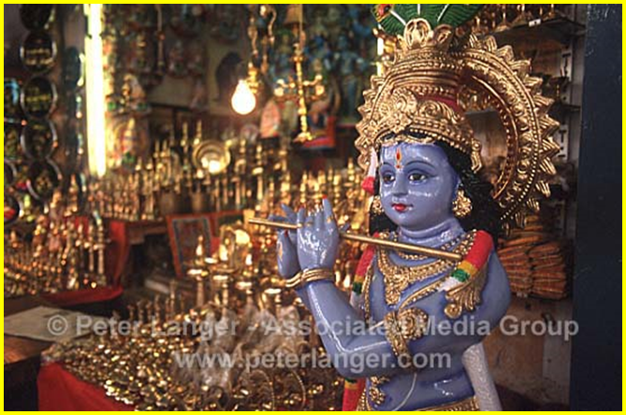
Hinduism

Slide 7
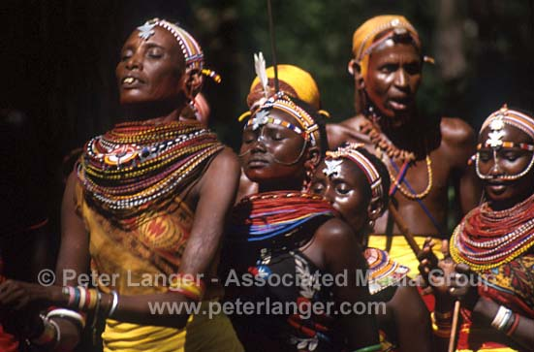
Animism
Animism is the belief that all living and nonliving things in nature have a spirit.
Animism was the belief system of many early civilizations.
Animism in early civilizations was often combined with ancestor worship.

Slide 8
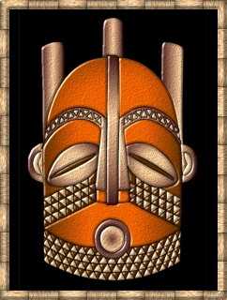
Animism dates back to earliest humans and still exists. It can be practiced by anyone who believes in spirituality, but does not proscribe to an organized religion. Animist gods and beliefs often explain natural earthly things. The presence of holy men or women, visions, trances, dancing, sacred items and places are often characteristic of animist societies. Animism exists in traditional African, Asian, American and Aboriginal cultures.

Slide 9
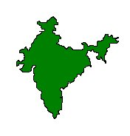
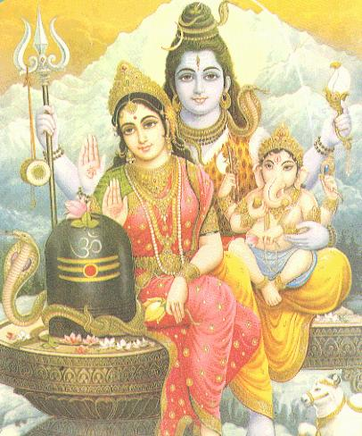
Hinduism has no single founder, but originated in India around 1500 BCE.
Hindus believe in one unifying spirit, Brahman. Brahman can manifest in many, polytheistic, forms or in one, monotheistic.

Slide 10
Hinduism is based on the concept of reincarnation (Spirits return to earth many times in different forms trying to become one with Brahman). The soul moves up or down a hierarchy depending on their behavior in life.
A person moves closer to Brahman by obeying the law of karma. Karma is the sum of all your deeds, good and bad. Good deeds involve following your dharma, or duties dependent on your position, gender and occupation.

Slide 11
The caste system (outlawed since 1948) was an important part of Hinduism. Castes are social classes into which a person is born and lives their entire life. If a person has a good karma they may be reincarnated into a higher caste.
This life
Next life
Good Karma
Higher caste
Born into
A caste
Bad Karma
Lower caste

Slide 12
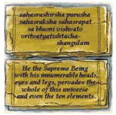
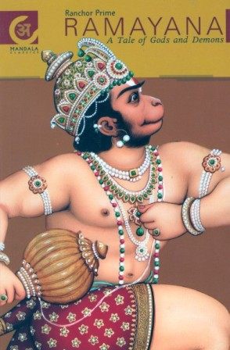
Over the centuries Hindu beliefs were recorded into a number of sacred texts including the Vedas.
The Ramayana is a Hindu creation story.

Slide 13
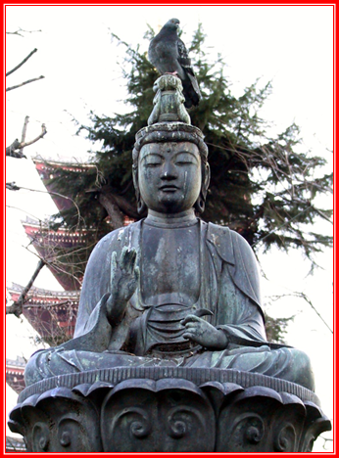
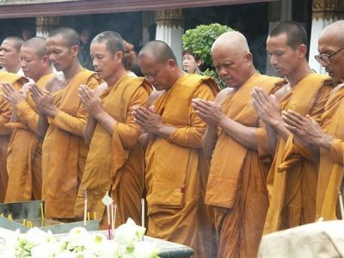
Buddhism

Slide 14
Buddhism was founded by Siddhartha Gautama in northern India around 560 BCE.
Gautama was born into a wealthy Hindu family, but renounced his wealth to seek spiritual enlightenment.

Slide 15
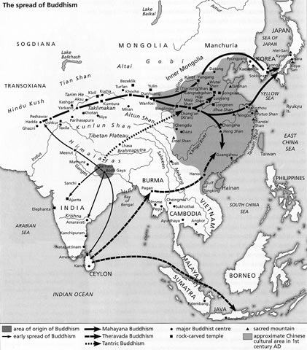
~Buddhism spread to eastern Asia, including China, Thailand, Korea and Japan.
~In other areas, Buddhism was adapted and took on new forms.

Slide 16
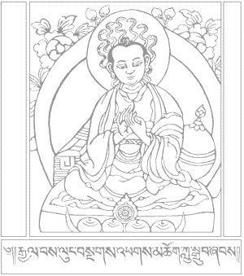
Buddhism is based on the Four Noble Truths.
1. All life is suffering.
3. The way to eliminate suffering is to eliminate desire.
2. Suffering is caused by desire for things that are illusions.
4. Following the Eightfold path will help people to overcome desire.

Slide 17
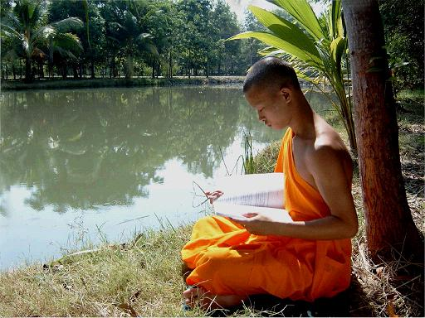

Slide 19
Buddhism has much in common with Hinduism, but important differences.
Buddhism like Hinduism:
Reincarnation
Karma
Dharma
But not
Caste system
Hindu gods
Hindu priesthood

Slide 20
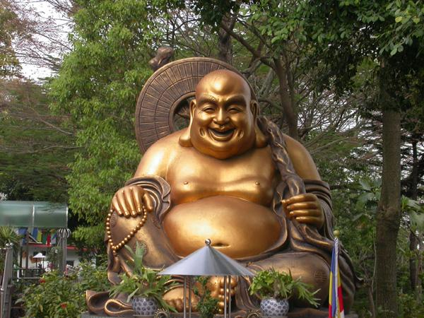
Sacred Buddhist Texts
Buddha did not record his teachings, but after he died, his followers collected them into the Tripitaka.

Slide 21
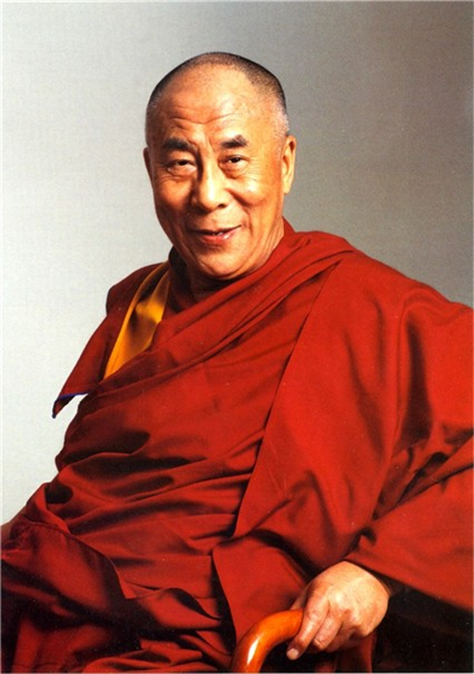
Today’s Tibetan Buddhists are led by the Dalai Lama, who advocates for freedom from China.

Slide 22
CLICK ME!

Slide 23
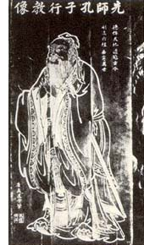
Confucianism
The father of Confucianism
Confucius:
Was born around 551 B.C.
In what is now the Shantung
Province

Slide 24
Confucianism
His teachings have touched almost every Chinese student for the past two thousand years.
Confucius believed that tradition was the key to peace, in this very unstable time.
He believed that tradition would show them the way back to a happy China.

Slide 25
Confucianism
Confucius had Five Ideals that guided his thoughts:
Jen: Is the ideal way for one to carry oneself through life. How you should be.
Chu Tzu: How a person should act.

Slide 26
Confucianism
Confucius had Five Ideals that guided his thoughts:
Li: The way things should be done. A father should be a father, and a ruler should be a ruler.
Te: Translates to “Power”. How the people with power, use it.

Slide 27
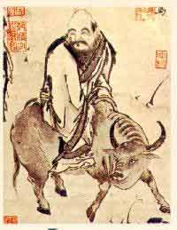
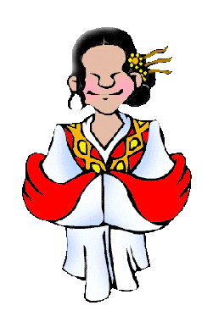
Confucianism
Confucius had Five Ideals that guided his thoughts:
Wen: Victory goes to the state with the highest culture. Art is powerful.
China placed the scholar-bureaucrat at the top of its social scale, and its soldiers at the bottom.

Slide 28
Confucianism
Confucius believed that without human relationships, there would be no self.
There are Five Constant relationships
in life:
Parent and Child
Husband and Wife
Elder Sibling and Junior Sibling
Elder Friend and Junior Friend
Ruler and Subject

Slide 29
CLICK ME!

Slide 30
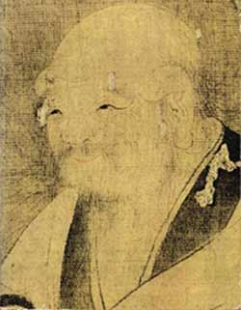
Taoism
The father of Taoism
Lao Tzu:
Was born around 640 B.C.
No one is really sure about
any dates or places.

Slide 31
Taoism
Is a philosophy or a way of life.
It teaches the way to happiness if to “go with the flow” (find the easiest path to get things done).
Everything alive in the universe shares a universal life force
The Tao Te Ching is the Taoist bible.
-It centers around the concept of Tao, or the “path”

Slide 32
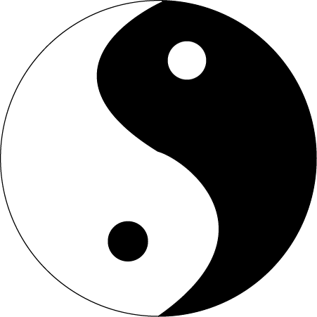
Taoism
The Taoist believe in opposites, and that things in nature have a way of working themselves out.
The yin (the dark side) is the side of women, themoon, things that are still like ponds, and death.
The yang (the light side) is the side of men, the sun, things that move like rivers, dragons, and creation and birth.
Everyone has some yin and yang in them and it’s important to keep them balanced.

Slide 33
CLICK ME!

Slide 34
CLICK ME!

Slide 35
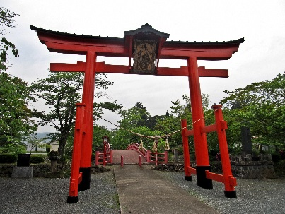
Shinto
“the way of the gods”
The indigenous faith of Japan, since ancient times
Shinto is a “symbol” of Japanese identity, and expresses a religious faith about Japan and its past
The central symbol of shinto is the “torii gate” (2 uprights and a cross beam)

Slide 36
FACTS
A very loosely-organized religion
No founder
No official sacred scripture
No fixed moral code
No belief in original sin or original ignorance
No savior
Shinto is shrine-centered and ritual-centered; not book-centered
Shinto may be regarded as an collection of peculiarly Japanese types of religious beliefs, sentiments, and approaches, which have been shaped and conditioned by the historical experience of the Japanese people from the prehistoric period to the present
Shinto is “caught, not taught” (transmitted from heart to heart through daily life)
A religion of joy, beauty of nature, wonder of life, peace and harmony with nature, and among people

Slide 37
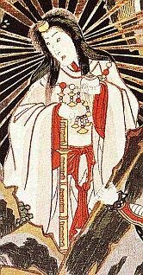
The Shinto View of God
Polytheism/animism
Basic concept is that of the “kami”
Not really a “god” in the Christian sense
More like honored sacred spirits who were worshipped
-They are elements in nature (sun, wind, moon), animals, creation forces, and some deceased.
-part of nature, both good and evil.
Most important goddess is Amaterasu, the Sun goddess.
Stories about her and other gods and goddesses are written
in the Kojiki (Records of Ancient Matters) and the
Nihongi (Chronicles of Japan).

Slide 38
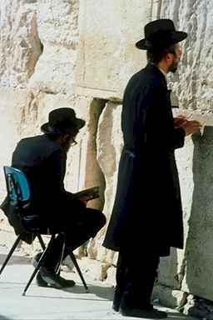
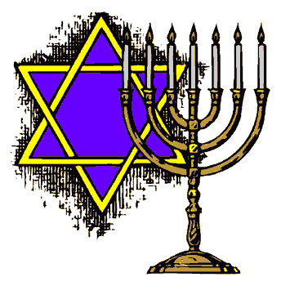
Judaism

Slide 39
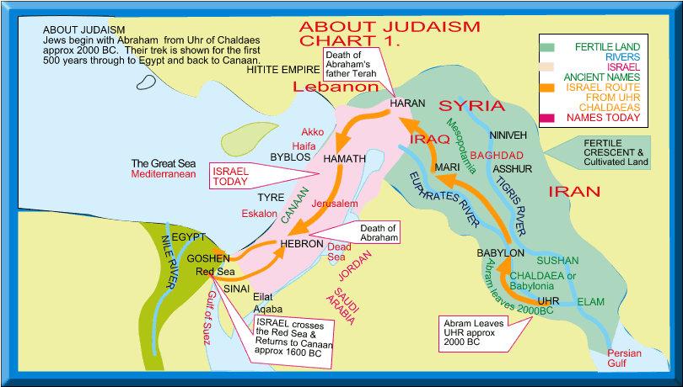
Judaism originated in the Middle East around 1000 BCE. According to Jewish tradition, God chose the Hebrews and helped them to escape slavery in Egypt. Judaism was one of the first monotheistic religions.

Slide 40
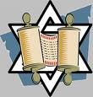
Basic Beliefs of Judaism
~The Torah is a sacred scripture recording laws and events in Jewish history.
~The Old Testament of the Bible includes the Torah.

Slide 41
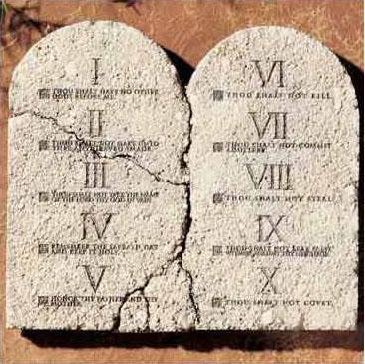
~God gave Hebrews the 10 Commandments through Moses.
~The Ten Commandments describe how people should behave toward God and one another (moral code).

Slide 42
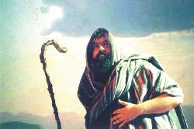
God made a promise to Abraham to be the God of the Hebrews.
Abraham is considered the “Father of Judaism.”
Judaism had a great influence on the later development of Christianity and Islam.

Slide 43
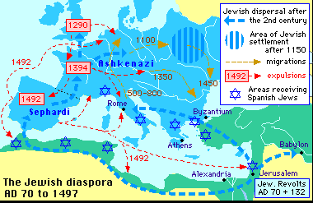
Jews were discriminated against in the Roman Empire and eventually kicked out of their homeland Israel.

Slide 44
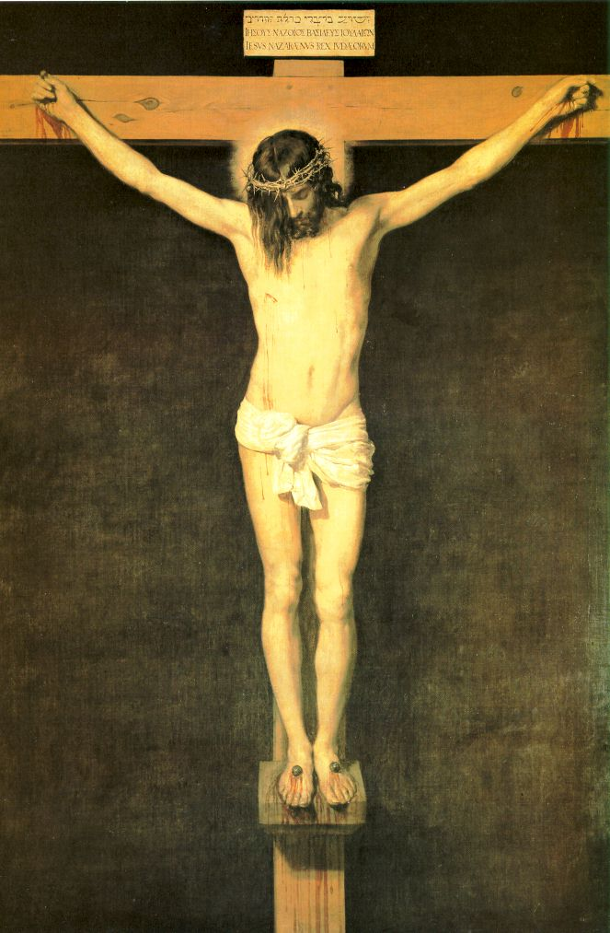
Christianity

Slide 45
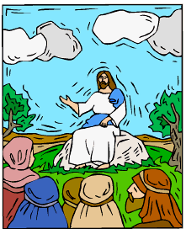
Christianity originated from Judaism about 30 CE.
Christians believe that Jesus was a Messiah, or savior
sent by God to bring eternal life to anyone who would follow him. Jesus accepted the Ten Commandments and also preached equality of man before God. The sacred text of Christianity is the Bible. Although the Romans originally felt threatened by the Christians, and therefore allowed Jesus to be crucified, Christianity eventually became the official religion of the Roman Empire.

Slide 46
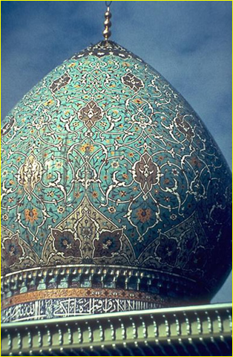
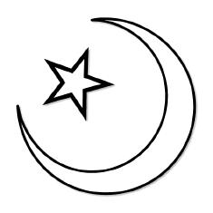
Islam

Slide 47
Islam originated in the Middle East around 622 CE with the Prophet, Muhammad. Muhammad was born in Mecca and traveled to Medina in a journey called the hajj, that became the founding of Islam.
Muslims are followers of Islam. They follow scriptures called the Quran, or Koran. The collection of Islamic laws is also known as the Sharia.

Slide 48
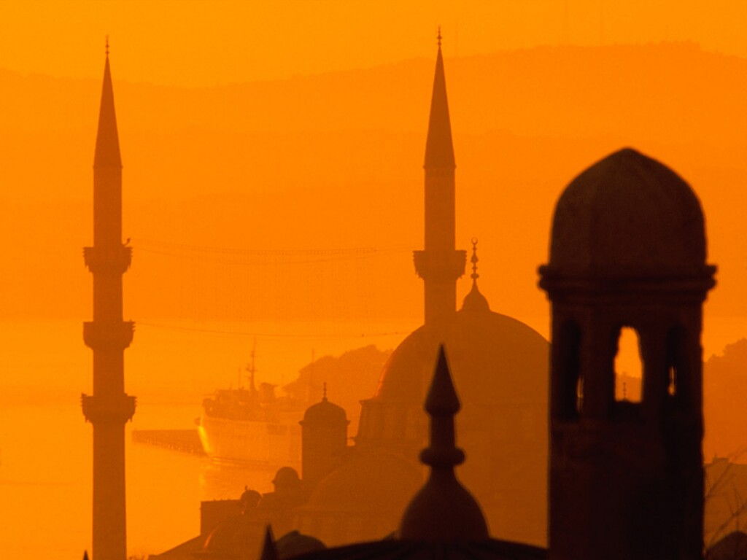
Five Pillars of Islam
Faith in one God, Allah—monotheism
Five times daily prayer toward Mecca
Help for the poor
Fasting during the holy month of Ramadan
Pilgrimage to holy city of Mecca

Slide 49
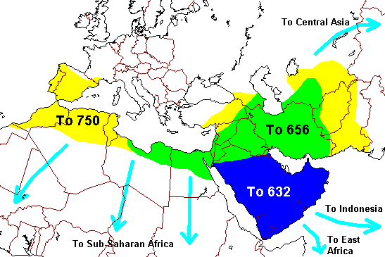
Spread of Islam--In the 150 years following the death of Muhammad, Islam spread through trade, missionaries and conquest into Asia and Africa.

