Slide 1
Greek
Mythology
By: Me!!! Of Course
Mrs. Langston

Slide 2
What is Greek Mythology?
Greek Mythology is a collection of myths and legends that Greeks used to explain their world, and how something came to be.
Although we now view these stories as fiction, the Greeks believed them to be true.

Slide 3
The Greeks and Their
Beliefs
The Greeks were “a tough, restless, ambitious, hard-living, imaginative race.”
The Greeks loved life.
They believed in living life to the fullest, because death was going to happen
whether you wanted it to or not.
The only response to death was to make a mark on the world. Be a legend…be grandiose.

Slide 4
Continued: The Greeks &
Their Beliefs
The Greeks had many gods.
The Olympian gods resembled the Greeks need to be grandiose.
Because the Olympian gods mirrored the Greeks, they were heavily flawed.
They were quarrelsome, unforgiving, jealous, vengeful, spiteful, sinful deities.
Because the Greeks focused on being grandiose, the Olympian gods were mostly portrayed as physically strong, beautiful and intelligent.
The same applies to the heroes in their legends and myths.

Slide 5
The World according to the Greeks
Both good and evil comes from the gods.
Heroes and monsters came from the gods.
This idea has influenced all religions that came after.
Many of the conflicts that are portrayed in the myths are between family members.

Slide 6
The World according to the Greeks
In the Beginning…
In the beginning there was no earth, sky or sea. There was only confusion and darkness, called Chaos. Chaos gave birth to Mother Earth. She eventually gave birth to a son, Uranus, also known as Father Heaven. Mother Earth and Father Heaven had many children.
• First, they had three monstrous sons. Each had fifty heads and one hundred hands.
•Then, they had three more sons. They were just as big and just as ugly. They were called Cyclops. They had one eye in the middle of their foreheads. They were as strong as Earthquakes and Tornadoes combined.
•Finally, they had the first gods, six sons and six daughters called the Titans.

Slide 7
Among their children was the greatest Titan, Cronus (Kronus). Cronus gained power from his father, Uranus, by castrating him. Then, Cronus became ruler over heaven and Earth and married his sister, Rhea. From their union came the Olympian gods. Power changed Cronus and made him evil. He was so afraid that one of his sons was going to do to him what he did to his father that he swallowed all of his children immediately after their birth. One by one, Cronus swallowed Hestia, Demeter, Hera, Hades, and Poseidon. When Rhea was pregnant with her sixth child, she thought of a plan. She secretly gave birth to her sixth child, Zeus, and gave him to Mother Earth. Mother Earth decided that the child would be safe if she hid him as far away from Cronus as she could. When Cronus asked to see the sixth child, Rhea handed him a rock wrapped in a blanket. Just like her previous children, Cronus swallowed the rock without hesitation, just as she had planned. Rhea was happy and could not wait for the day Zeus would grow up and destroy his father.

Slide 8
Zeus was safely being raised by Nymphs and shepherds. Eventually Zeus grew up and Rhea, his mother, told him about what Cronus did to his siblings. Zeus made a promise to his mother that he would make Cronus pay for what he did.
Rhea and Zeus’ plan
When Zeus returned to his mother, she disguised him as a servant. Rhea concocted a poisonous potion and Zeus, acting as a servant, put it in Cronus’ drink. The concoction caused Cronus to get sick and vomit. First, Cronus vomited up the rock. Then each of his five children, one by one. Zeus was seen as a hero for saving his siblings. They were extremely thankful. Once everyone was freed, the six children decided to battle against Cronus.

Slide 9
The battle between father and sons
The war lasted ten years. Neither side could get the upper hand because they were equal in strength. Mother Earth suggested that Zeus and his brothers go free the Cyclops and have them fight on their side. Zeus and his brothers did as they were advised and freed their uncles, the Cyclops. The Cyclops gave them the advantage they needed. Finally, the war was over. Zeus and his siblings were
victorious.

Slide 10
After the battle was over
Now that the battle was over, the three brothers had to decide who was going to rule the universe. They decided the fairest way to choose was to draw lots. Hades won the underworld. Poseidon won the sea and Zeus won the heaven and became ruler of all the gods of Mt. Olympus.

Slide 11

The gods and goddesses of Mt. Olympus
• Mt. Olympus was the largest mountain in Greece. It was the home of the gods and goddesses.
• Gods and goddesses were immortal, they could not die.
• No humans were allowed on top of Mt. Olympus, but the Olympians were
allowed on Earth.

Slide 12

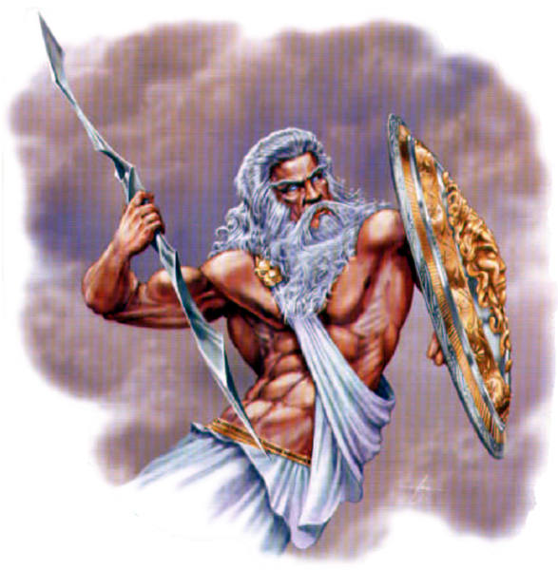
Zeus
He ruled the Olympians.
He was the god of the sky.
Known for lightning and thunder.
Carrying a thunderbolt as his symbol.
He married Hera, his sister, which was a family habit.
He fathered many children with various goddesses and mortals.

Slide 13
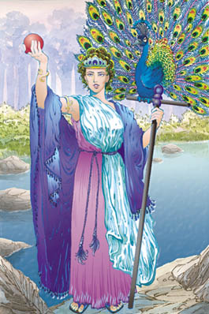
Hera
Wife and sister of Zeus
Goddess of marriage, protector of childbirth & heroes
Portrayed as extremely jealous and vindictive. She took many
forms, among them that of a bird.
She was associated with the peacock, because of her great beauty.
She and Zeus were always quarreling.
She was called the queen of intriguers, a vindictive and jealous wife, who frequently outwitted her husband, Zeus.

Slide 14
Interesting Fact:
Hera hated the great hero Heracles since he was the son of her husband Zeus and a mortal woman. When he was still an infant, she sent snakes to attack him in his crib.
Hera was worshipped throughout Greece, and the oldest and most important temples were dedicated to her.

Slide 15
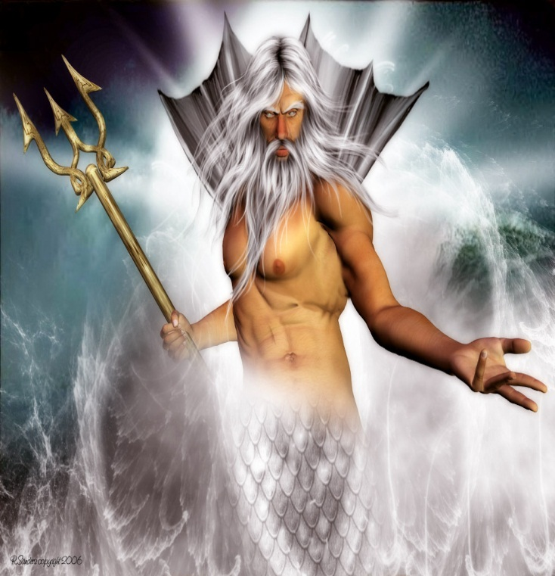
Poseidon
God of the sea, horses and earthquakes
Lives in a palace beneath the ocean
Carries a three-pronged trident
Gave people the horse, created it for his sister
Married a sea nymph named Amphitrite
Very fond of his sister Demeter

Slide 16

Interesting fact:
When the Olympians gained control of the universe, they agreed that the earth
would be ruled jointly, with Zeus as king. This led to a number of territorial disputes among the gods. Poseidon vied to be the ruler of Athens. He
demonstrated his power by striking the Acropolis with his three-pronged spear, which caused a spring of salt water to emerge.

Slide 17
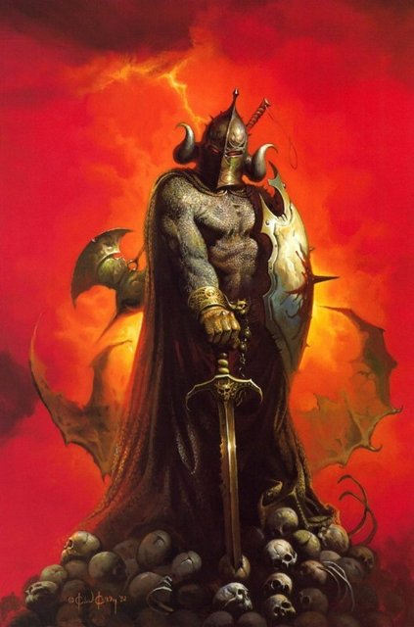
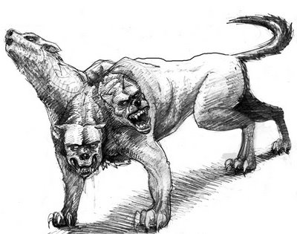
Hades
He was the jealous brother to Zeus and Poseidon.
He made Persephone his wife after stealing her from her mother, Demeter, who was his sister.
Because he was a violent god, who was also very possessive of every new soul, he rarely left his underworld domain.
God of the underworld and the dead god of wealth
Owned all of the precious metal on Earth
Wore a cap that made him invisible

Slide 18
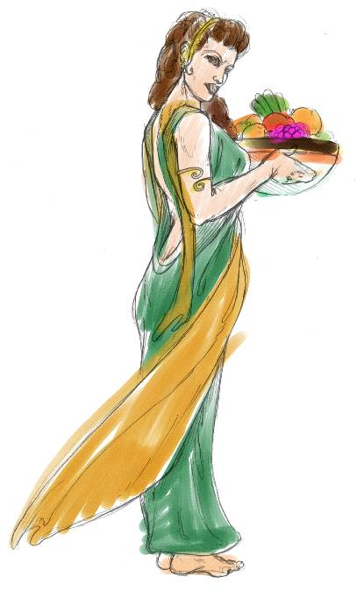
demeter
Demeter means “Barley-mother”
Another name for her is Ceres, from the word cereal
Goddess of the cornfield, mistress of planting and harvesting, lady of growing things
Interesting fact: Demeter’s daughter, Persephone, was gathering flowers one day when the earth opened up and Hades, King of the Dead, emerged from the Underworld. He took Persephone and carried her off to his realm, where she became his queen. Demeter was heartbroken and wondered the earth looking for her daughter. During this time the crops withered, and it became an endless winter. Hades eventually surrendered Persephone for one half of the year – the spring and summer seasons. During the other half of the year that she spends in the Underworld coincides with the barren season.

Slide 19
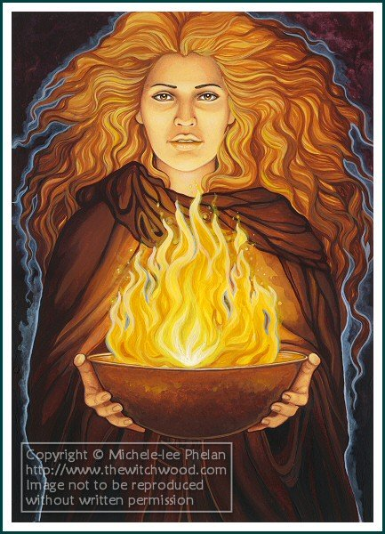
hestia
She was the sister of Zeus and the daughter of Cronos and Rhea.
Her only job was to keep the fire lit in the hearth on Mt. Olympus
She represented personal and communal security and happiness.
She was thought of at the kindest and mildest of the goddesses.
Didn’t appear in many myths

Slide 20
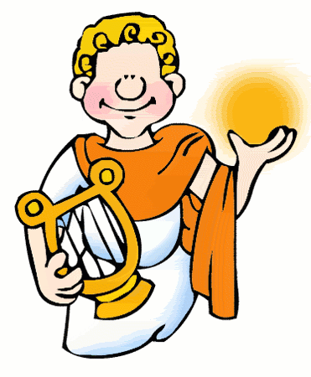
apollo
god of light, music and poetry most beautiful god
also the god of medicine
taught people the art of healing
could predict the future
brother of Artemis
Often shown playing the lyre, and it is said that he invented the lute

Slide 21
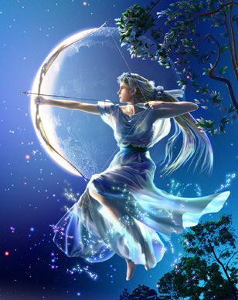
artemis
She was the twin sister of Apollo,
mother was Leto and father was
Zeus.
Always carried a silver bow and arrows.
She ruled over the untamed places of the earth.
She decided never tomarry

Slide 22
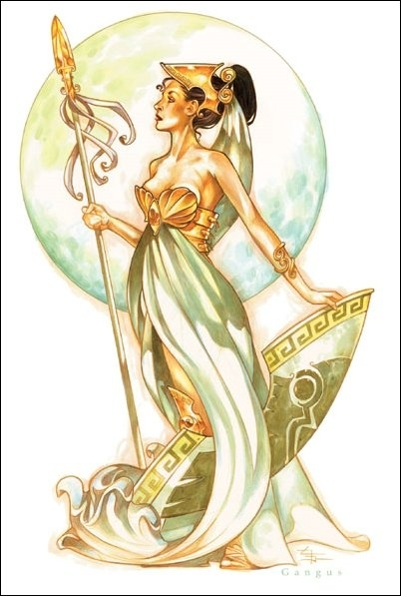
athena
Zeus’ favorite
goddess of wisdom, strategy, protector of cities and civilizations
goddess of handicrafts and art
She sprang from her father’s head fully grown and in armor.
Hephaestus, Zeus’ son, had to release Athena by cutting his head open
with an ax. She was the best-loved goddess on Olympus.
She hated Ares, god of war, often besting him in battle.
The Greek city of Athens is named after her.
She was said to have created the spider.

Slide 23
Interesting fact:
Both Athena and her brother, Poseidon, wanted to be the patron deity of Athens. Athena proved her worthiness for this honor by causing an olive tree to spring up on the Acropolis. Poseidon struck the ground and caused a spring of water to gush forth. But, because he was the god of the sea, the water was salty. The Athenians considered Athena’s gift to be more useful, so she became the city’s patron deity.

Slide 24
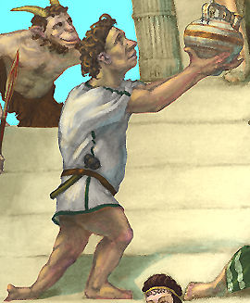
Hephaestus
peaceful, loving and popular.
he walks with a limp and he was the ugliest of the
gods, who was rejected by his mother, Hera, and she hurled him off of Mount Olympus crippling him.
Made all the Olympians’ thrones, armor, furniture and weapons
Married Aphrodite

Slide 25
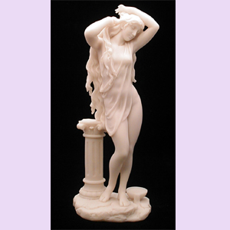
APHRODITE
She is the goddess of LOVE
Born from sea foam. Another myth credits her mother as
Dione and her father as Zeus.
After all the gods on Mount Olympus courted her, she married Hephaestus, the ugliest of the gods.
Because she was judged the most beautiful of all the goddesses on Mount Olympus
by Paris, the other goddesses envied her.
Wherever she walked flowers sprang up beneath her feet
Her son is Eros (Cupid)

Slide 26
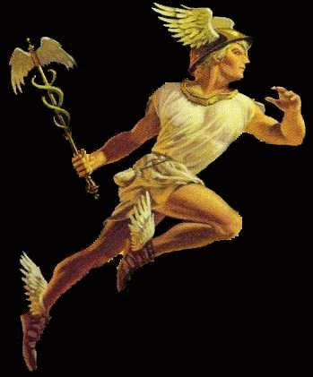
HERMES
Zeus’ graceful, happy son by the goddess, Maia
God of shepherds, merchants, travelers and thieves
Very mischievous and tricky
Guided the newly dead to the underworld
Invented the alphabet, astronomy, scales, playing cards and card games
Zeus’ messenger
Wore winged sandals and a winged cap
Had a son named Pan. He was half goat.

Slide 27
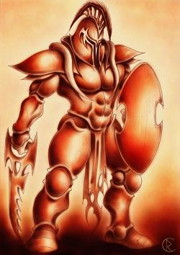
ARES
god of war
Boastful, cruel and had no manners
Son of Zeus and Hera
Loved to fight, but was a coward once he got hurt
Wherever he went there was violence and bloodshed
The curse of mortals
Ares is often shown carrying a bloodstained spear,
and his throne on Mount Olympus was said to be covered in human skin.
• Interesting fact: Although he is an immortal deity, he was almost killed when he was defeated by Heracles in battle and then stuffed into a jar by two giants.

Slide 28
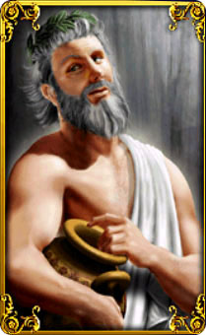
DIONYSUS
God of wine
Dionysus was the son of Zeus and the mortal
He is said to be the only god on Olympus with a mortal parent.
His creation of wine brings ecstasy and drunkenness to his revelers.
Much of the ancient world’s greatest poetry was created in his honor.

