Slide 1
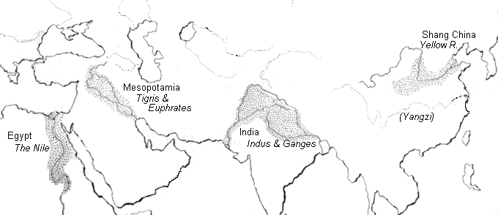
4 Early River Valley Civilizations
Sumerian Civilization - Tigris & Euphrates Rivers (Mesopotamia)
Egyptian Civilization - Nile River
Harappan Civilization - Indus River
Ancient China - Huang He (Yellow) River

Slide 2
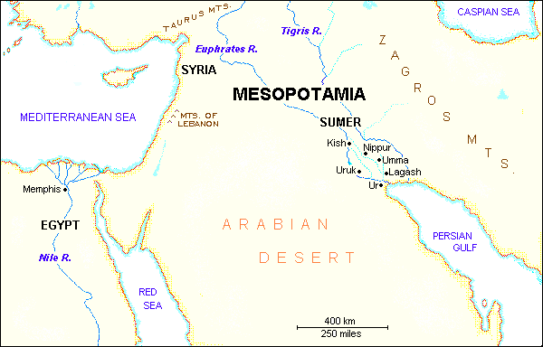
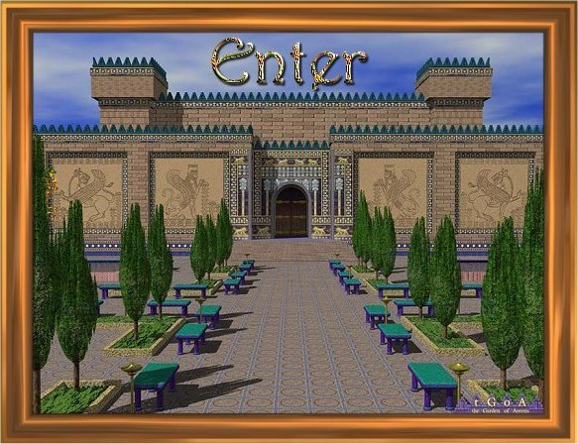
Sumerian Civilization - Tigris & Euphrates Rivers (Mesopotamia)
City-States in Mesopotamia

Slide 3
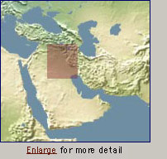
City-States in Mesopotamia
I. GEOGRAPHY
A. Mostly dry desert climate in SW Asia (Middle East)
1. Except in region between Tigris / Euphrates rivers
2. a flat plain known as Mesopotamia lies between the
two rivers
3. Because of this region’s shape and the richness of its soil,
it is called the Fertile Crescent.
- the rivers flood at least once a year,
leaving a thick bed of mud called silt.
SW Asia
(the Middle East)
Silt is a sedimentry rock that is carried by water such as creeks and rivers. It is used for growing crops as it is rich, and really fertile soil.
Fertile Crescent

Slide 4
City-States in Mesopotamia
I. GEOGRAPHY
B. Three Disadvantages / Environmental Challenges
1. Unpredictable flooding / dry summer months
2. No natural barriers for protection
- small villages lying in open plain were defenseless
3. Limited natural resources
- stone, wood, metal
PP Design of T. Loessin; Akins H.S.

Slide 5
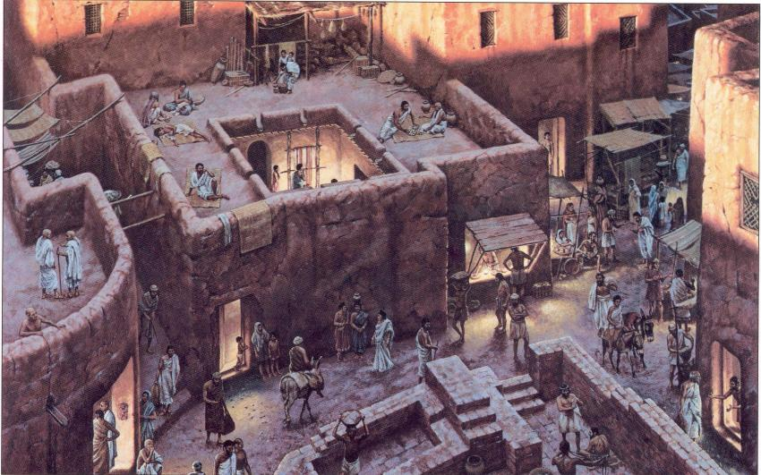
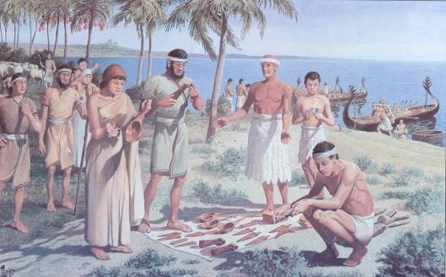
City-States in Mesopotamia
I. GEOGRAPHY
C. Solutions
1. Irrigation ditches
2. Built city walls with
mud bricks
3. Traded with people
around them
for the products
they lacked.
Initiated Bronze Age.
PP Design of T. Loessin; Akins H.S.

Slide 6
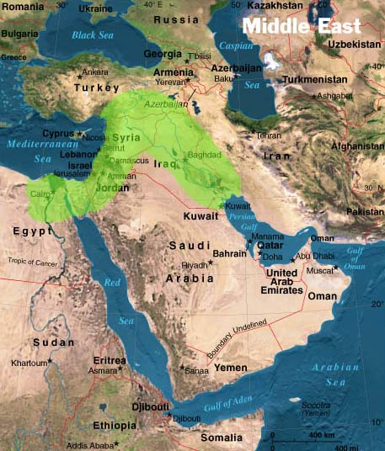

Mesopotamia was located in what is now the country of Iraq.

Slide 7
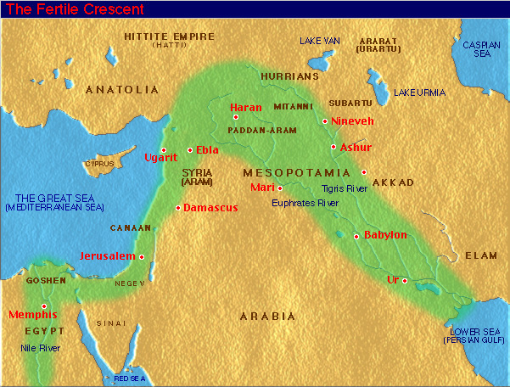
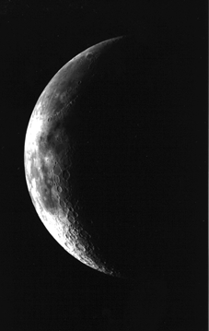

Mesopotamia was part of a larger region called the Fertile Crescent. This area, that stretched from the eastern edge of the Mediterranean Sea down to the Persian Gulf, had fertile soil and was where many civilizations started. The shape is somewhat similar to a crescent (think of a crescent roll, or a crescent-shaped moon).

Slide 8

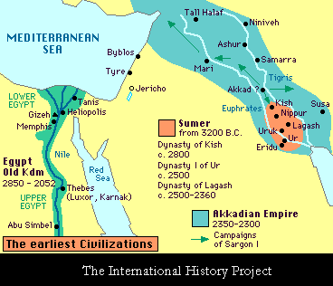
City-States Formed Along the Rivers
Many city-states formed along the Tigris and Euphrates Rivers in Mesopotamia. They each had their own form of government, and the people worshipped different gods and goddesses. Eventually, they each had their own kings. The region where the two rivers meet was called Sumer. The people who lived in the Sumer region were called Sumerians.

Slide 9
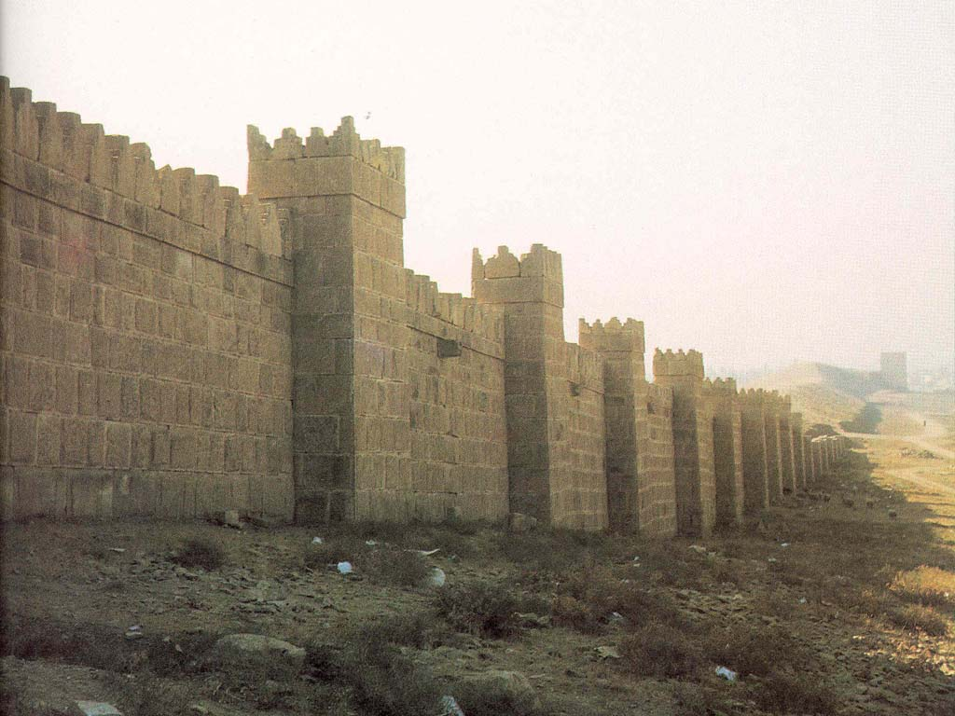
Why Did These Cities Develop?
The Sumerians were the first people to migrate to the Mesopotamia area. Due to the fertile soil in Mesopotamia, farming was very successful. In fact, people were able to create surpluses of food. This meant that some people could stop farming and begin doing other things, like building a city.
As cities began to develop, people began to worry about others who might come and invade their city. They wanted to protect themselves from enemies, so people in Mesopotamia built walls around their cities.

Slide 10
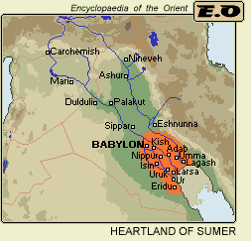
Sumerians
Writing first began in Sumerian cities. The first schools were set up in Sumer over 4,000 years ago. Sumerian schools taught boys the new invention of writing. Those who graduated became professional writers called scribes. Scribes were the only people who could keep records for the kings and priests. Boys that wanted to be scribes had to attend school from the age of 8 to the age of 20.
Remember, Sumer is the region where the Tigris and Euphrates Rivers meet.

Slide 11
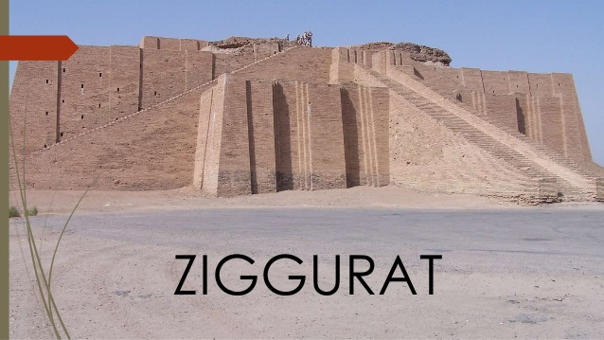
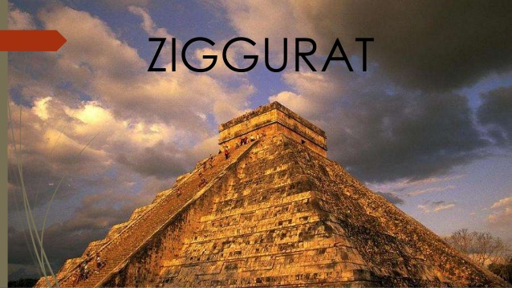
Based on what you learned so far……..
What was the ziggurat made from?
Why was it not made from wood or steel?
Where was it most likely located and why was it placed there?
We will learn more about the ziggurat when we start our religion unit.

Slide 12

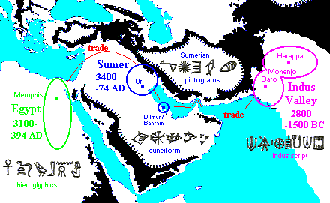
Cultural diffusion is the spread of elements of one culture to another people,
generally through trade.
Take the spread of writing. Similarities between the pictograms of Egyptian hieroglyphics, Sumerian cuneiform, and the Indus script are striking.
Can you give examples of cultural diffusion in your society today?
PP Design of T. Loessin; Akins H.S.

Slide 13
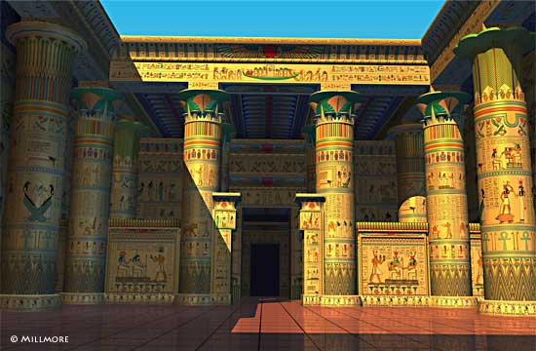
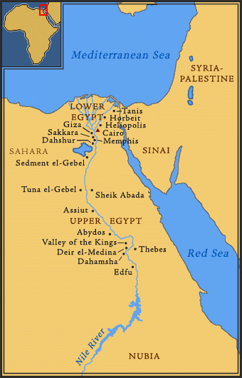
Egyptian Civilization - Nile River
ENTER

Slide 14
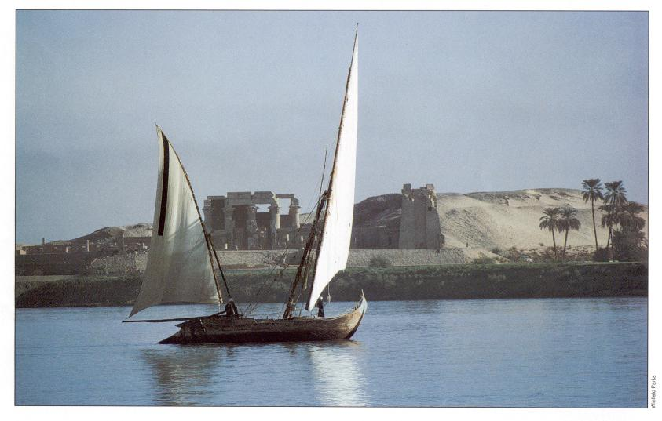
Examine this quote:
“Egypt, the gift of the Nile.”
~ Herodotus, Greek historian (484-432 B.C.E.)
What do you infer from this quote, what did Herodotus mean by it?

Slide 15
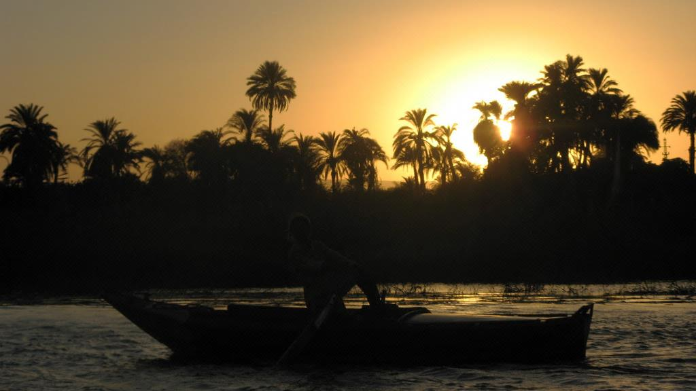
Geography…
The Egyptians, like the Mesopotamians, settled near a river because of the benefits and contributions it gave.
Do you remember some of the reasons?
      Travel
      Trade
      Irrigation for crops
      Water for drinking and cooking
      Yearly flooding, which left behind rich, fertile soil

Slide 16
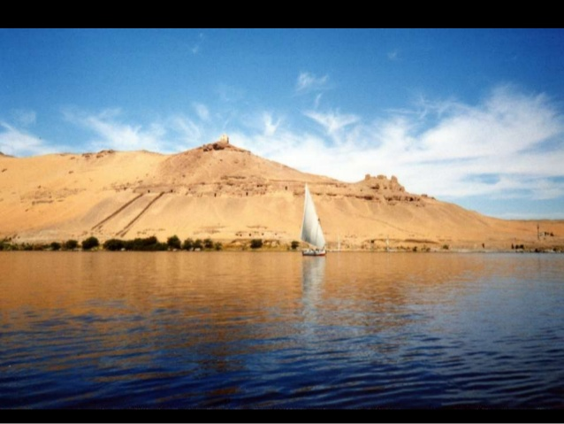
“Gifts of the Nile”
The Nile River is known as the “Giver of Life.”
It provided many things for the Egyptians to survive:
  Fertile soil for farming
  Fishing- food
  Fresh water
  Transportation
  Trade routes
The Nile was unfortunately also a taker of life.
  Many people accidentally drowned.
  Extreme rainfall washed away crops.
  Light flooding resulted in poor soil and crops would not grow.

Slide 17
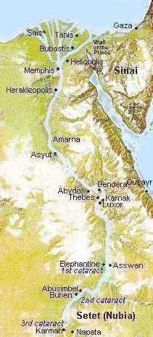
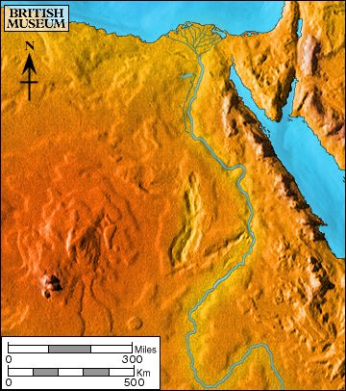
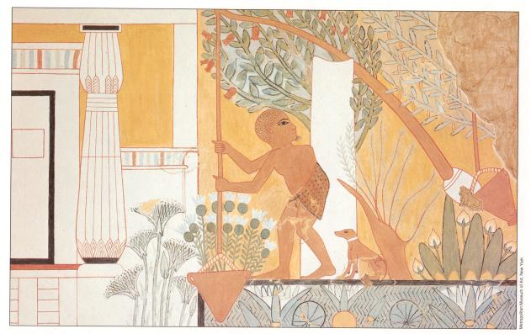
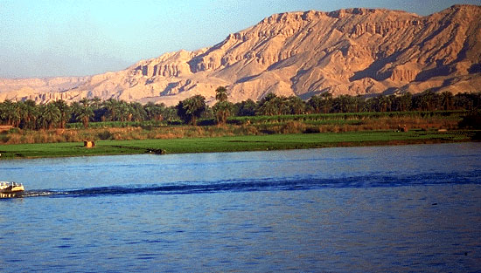
Egypt on the Nile
I. GEOGRAPHY
Nile River
A. The Nile
1. Egypt’s settlements arose along narrow strip of land made
fertile by the river
2. Yearly flooding, but predictable
Regular cycle: flood, plant, harvest, flood, plant, harvest...
3. Intricate network of irrigation ditches
Irrigating scene painted on tomb at Thebes

Slide 18
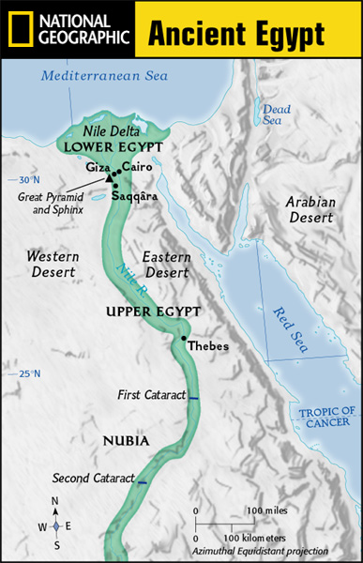
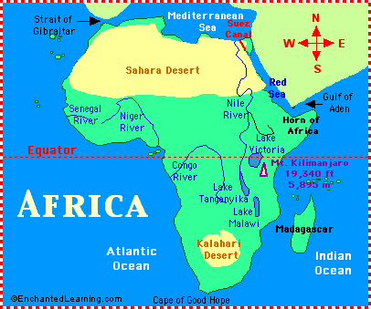
I. GEOGRAPHY
B. Upper and Lower Egypt
1. Most of Egypt’s history focused around
Lower Egypt,
around the Nile delta which flows into the Mediterranean Sea.
2. Upper Egypt developed later upstream
3. Nile provided reliable transportation
C. Environment
1. Unlike Mesopotamia, the Nile was predictable
2. Deserts on both sides of Nile
- provided natural protection against invaders
- also reduced interaction with other people
Egypt would develop mostly in isolation and therefore, a culture that was quite unique.

Slide 19
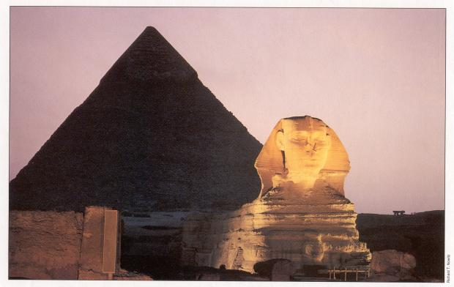
The Sphinx and Pyramid of Khafre at Giza.

Slide 20
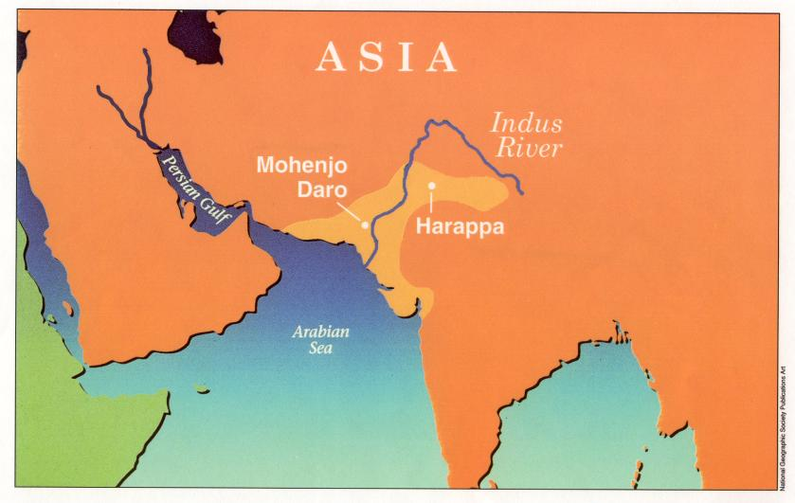
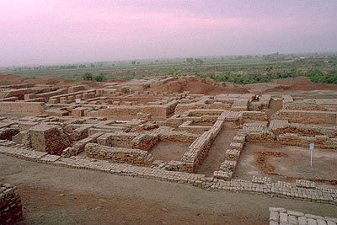
Harappan Civilization - Indus River
ENTER
The ruins of Mohenjo-Daro; Indus Valley
http://www.fsmitha.com/h1/map06ind.htm

Slide 21
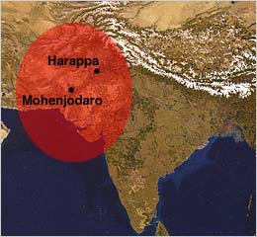
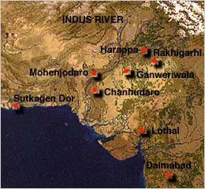
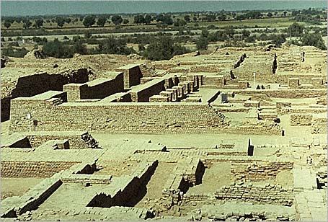
The Indus Valley civilization flourished around 2,500 B.C.
in the western part of South Asia,
in what today is Pakistan and western India.
It is often referred to as Harappan Civilization
after its first discovered city, Harappa.
The nearby city of
MohenjoDaro is the largest and most
familiar archaeological dig in this region.
The Indus Valley was home to
the largest of the four ancient
urban civilizations of Egypt,
Mesopotamia, India and China.
This ancient civilization was not discovered
until the 1920's.
Most of its ruins, including
major cities, remain to be excavated.
Left: The excavated ruins of Mohenjo-daro.

Slide 22
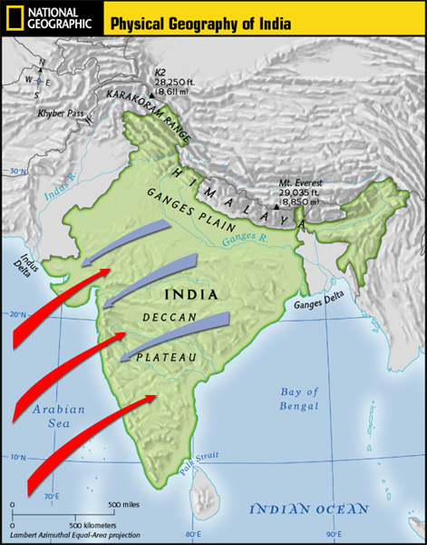
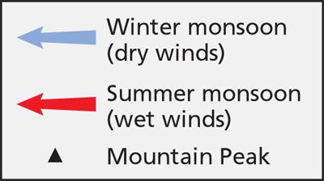
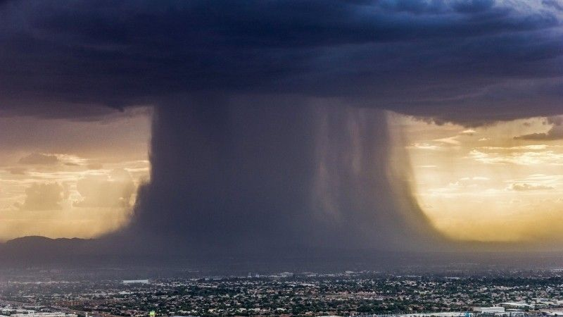
1. What challenges did the people along
the Indus River face?
2. What is a Monsoon?
Monsoon-is a weather condition that is actually defined as a season. A seasonal shift in wind direction. It can cause heavy rainfall during the summer and dry spells in the winter.
unpredictable rivers
(similar situation to Mesopotamia region)
strong winds / monsoons

Slide 23
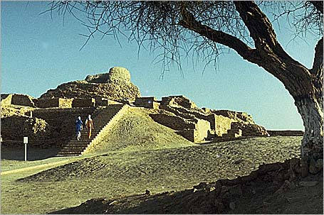
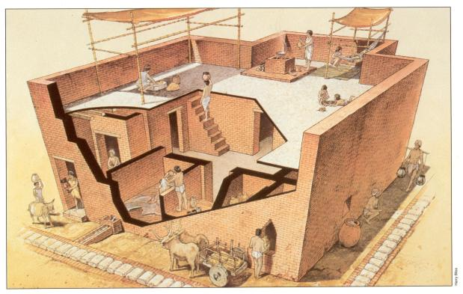
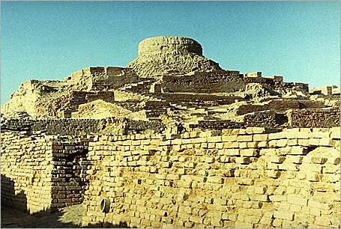
Left: The excavated ruins of Mohenjo-Daro – one of several planned cities laid out on a grid system in the Indus region.
Right: The citadel at Mohenjo-Daro.

Slide 24
Ancient China - Huang He River

Slide 25
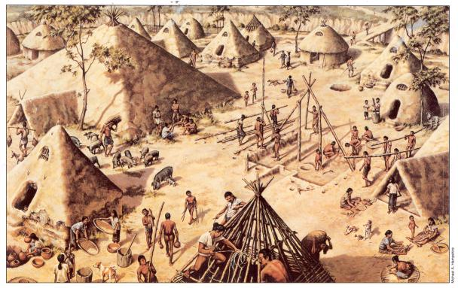
Ancient China (Huang He River)
An artist visualizes what the ancient Chinese village of Banpo
on the Huang He may have looked like over 4,000 years ago.
ENTER

Slide 26
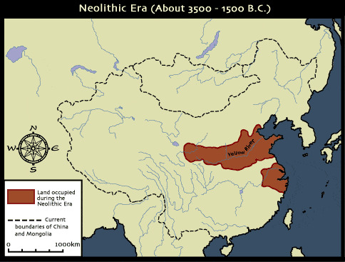
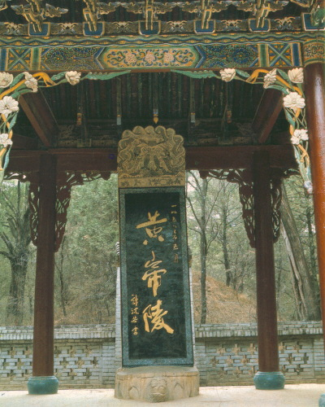

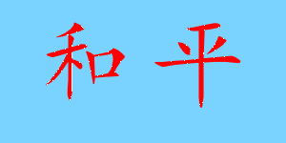

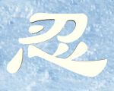


Gobi Desert
Taklimakan Desert
Himalaya Mts.
China’s geography ocean, desert, high mountains, isolated China.
Isolated geographically, cut off from trade, there would be little opportunity for cultural diffusion in
China’s case. Developing in a vacuum, China’s civilization would stand out as the most unique of our world’s early civilizations.
PEACE
LOVE
TOLERANCE
LUCK
ETERNITY

Slide 27
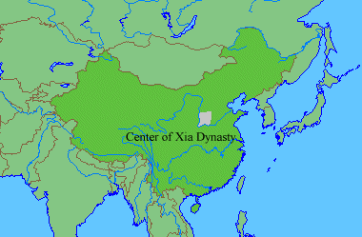
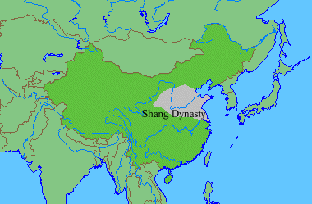
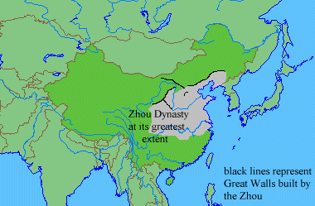
Ancient
China
Neolithic ca. 12,000 - 2000 B.C.
Xia ca. 2100-1800 B.C.
Shang 1700-1027 B.C.
Western Zhou 1027-771 B.C.
Eastern Zhou
770-221 B.C.
Warring States period
475-221 B.C.

Slide 28
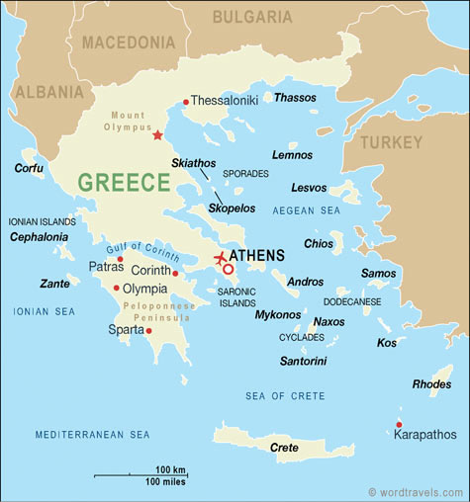
Ancient Greece :
Geography and Early Greeks
Main Physical Features
Seas
Mountains
Coastlines
Islands
Peninsula
What countries
and bodies of water surround Greece?

Slide 29
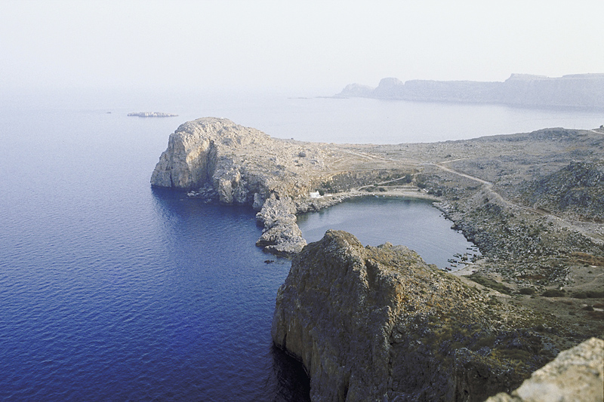
The Geography of Greece
Greece is
located in
Europe.
Greece is a peninsula with many smaller peninsulas branching off the mainland.
Greece is also made up of many islands.
Much of Greece is dominated by mountains that run to the sea.
Rocky coasts made farming difficult and made people settle in villages
that were isolated from one another.

Slide 30
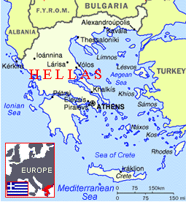
Basically, Greece is a mountainous peninsula
with islands.

Slide 31
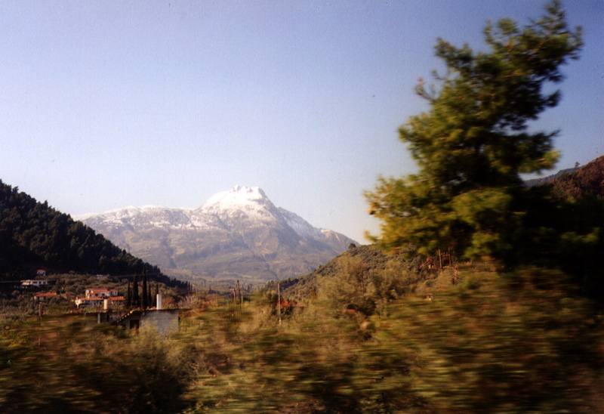


Ancient Greece consisted of a large mountainous peninsula and islands in the Aegean Sea.
Greece mountainous hilly terrain made farming difficult
But its location encouraged trade.

Slide 32

The ancient Greeks farmed but it was tough. Hills are not suited for farming. Greece’s mountainous terrain separated the ancient Greek cities. Greek communities often times developed independently because of the mountains, thus they were diverse and they fought each other a lot.

Slide 33


However, there is always the sea.
Even today, the Greeks have access
to the Mediterranean Sea and the
Aegean Sea.
The seas allowed the Greeks to travel and trade.
Trade encouraged cultural diffusion.
The Greeks were exposed to the Phoenician alphabet and Egyptian geometry.

Slide 34

Trade with Greece
Greeks took to the sea for transportation and communication.
The Greeks became skilled shipbuilders and sailors.
As the Greeks traveled, they found sources of food and other products they needed to survive.
How is the way the Greeks found food to survive different with that of the
Mesopotamians, Egyptians, or Indians?

Slide 35



The Minoans
What do you notice about the Minoan pottery?
The Minoan
culture collapsed
when a giant wave
flooded Crete.
The Minoans were one of the first cultures to develop in Greece.
It developed on the island of Crete.
Minoans traded wood, olive oil, and pottery for copper, gold, silver, and jewels.
Minoans aren’t
considered to
be Greek.

Slide 36




Greeks Colonize Greece
Greeks and city-states traded olives, wine, copper, and iron.
Greeks became worried and curious and began to branch out all over Europe.
Some cities around the Mediterranean Sea that exist today began as Greek colonies.
These cities include Istanbul, Marseille, and Naples.
City-states
became
richer through
trade.

